Slide 1
Annotation by flattening the knowledge graph
Source
Parameter [´parent term’]
Sink
´child term’
´child term’
´child term’
´child term’
´child term’
A
B
C
D
Low-friction metadata annotation
Familiar spreadsheet, row/column-based environment

Slide 2
Annotation principle
Sample
Parameter [instrument model]
Data
´TripleTOF4600 ’
´TripleTOF4600 ’
´TripleTOF4600 ’
´TripleTOF4600 ’
´TripleTOF4600 ’
A
B
C
D
Low-friction metadata annotation
Familiar spreadsheet, row/column-based environment

Slide 3
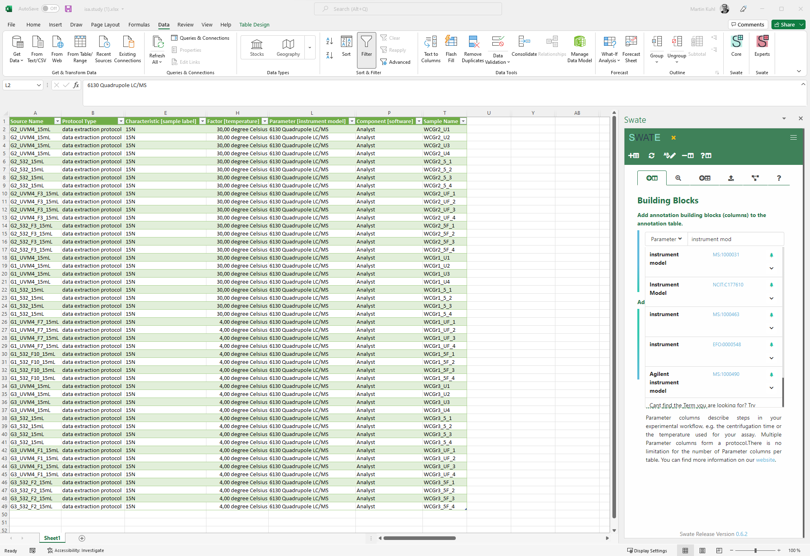
New Parameter

Slide 4
New Parameter
Source
Characteristic
Component
Protocol Type/ Protocol REF
Factor
Sample Name/
Raw Data File
Derived Data File

Slide 5
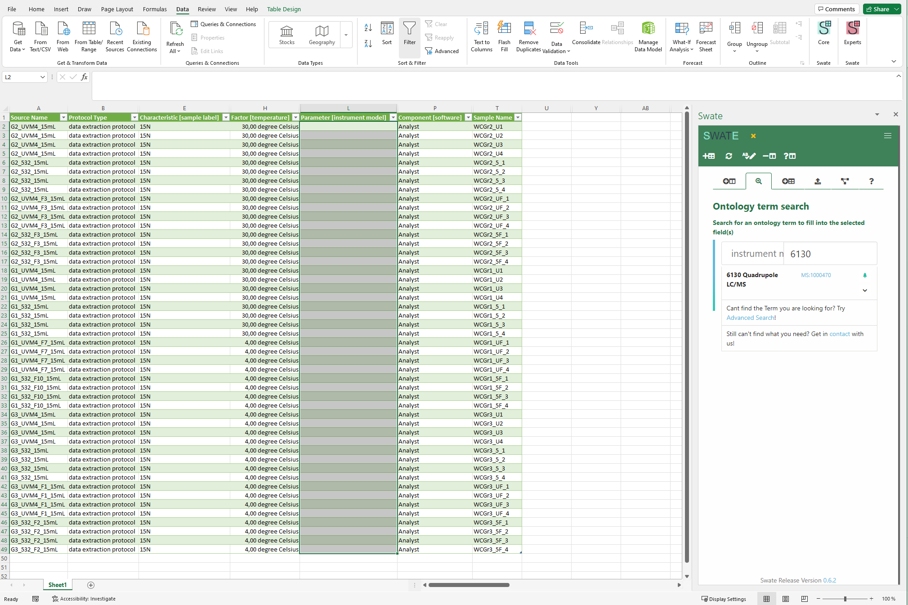

Slide 6
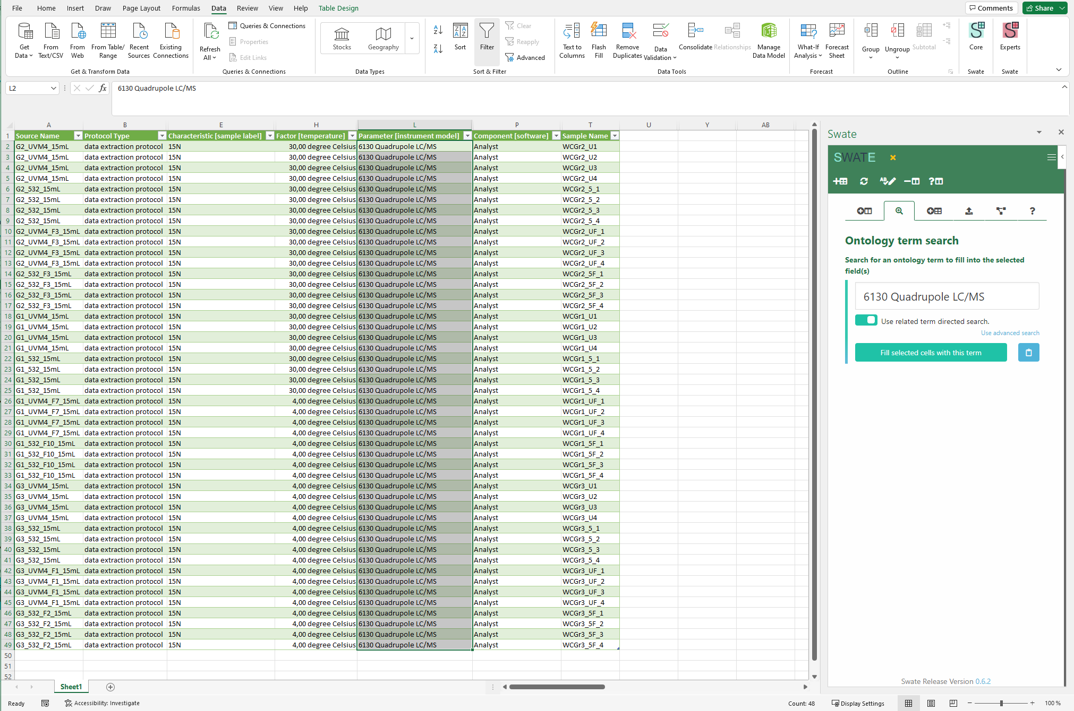

Slide 7
Fallibility by hierarchical combination of ontologies
container ontology
bio & tech ontologies
+
…
Source
Parameter [´term a’]
Characteristics [´term b’]
Sink
´value a’
´value b’
Process A
Process B
Process C
isa.study.xlsx or isa.assay.xlsx

Slide 8
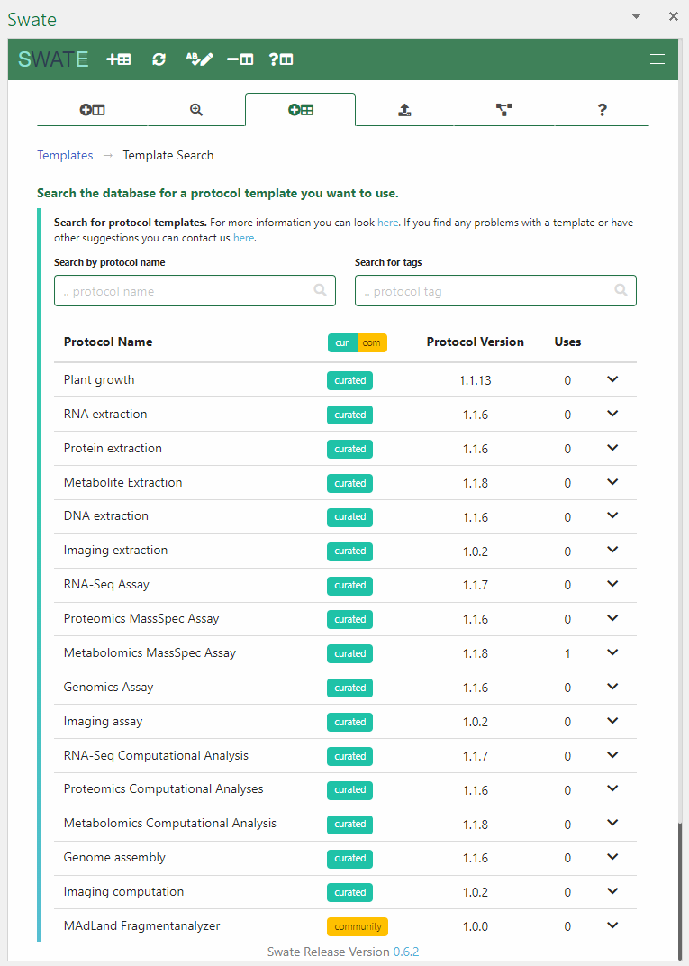

Slide 9
Template and checklists
=
Source
Parameter [´parent term’]
Sink
´child term’
´child term’
´child term’
´child term’
´child term’
A
B
C
D
Checklist and requirements can be represented as templates

Slide 10



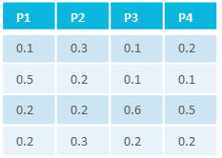
Realization of lab-specific metadata templates
measurements
processing
=
analysis
intensity
m/z
Sink
P1
P2
P3
…
Pn
Source
AGGTG
AGAGG
CAGAGGTGA
CAGAG
CAGAG
GGTGA
AGAGG
GAGGT
GAGGT
AGGTG
CAGAGGTGA
GGTGA
Sink
P1
P2
P3
…
Pn
Source

